Slide 1
Trapping analysis of a magnetic electron by a circularly polarized electromagnetic wave in static electric field
11/30/2025

Slide 2
Introduction section
Acceleration mechanisms
Autoresonance
Betatron resonance
Ponderomotive-force-driven acceleration
Landau resonant
Trapping mechanisms
optical tweezers
ponderomotive potential wells (generated by the spatial interference patterns of laser beats )

Slide 3
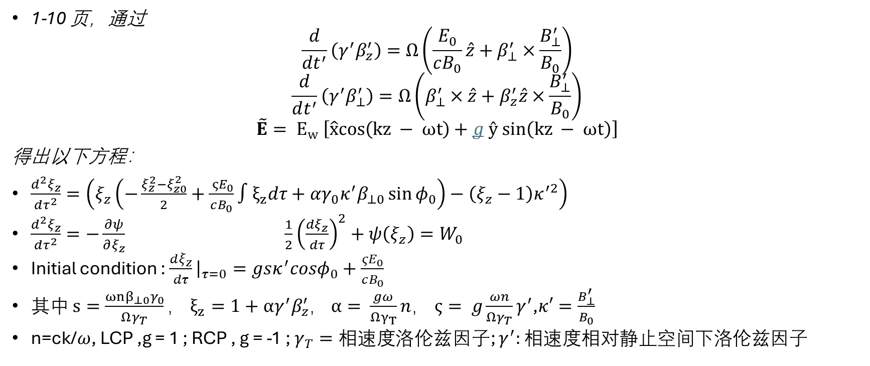
Pseudo-potential model for wave-electron interaction
1-10 页，通过
$$\frac{d}{dt^{′}}\left(γ^{′}β_{z}^{′}\right)=Ω\left(\frac{E_{0}}{cB_{0}}\hat{z}+β_{⊥}^{′}×\frac{B_{⊥}^{′}}{B_{0}}\right)$$
$$\frac{d}{dt^{′}}\left(γ^{′}β_{⊥}^{′}\right)=Ω\left(β_{⊥}^{′}×\hat{z}+β_{z}^{′}\hat{z}×\frac{B_{⊥}^{′}}{B_{0}}\right)$$
$$\tilde{E}= E_{w} \left[\hat{x}cos\left(kz − ωt\right)+g ŷ sin\left(kz − ωt\right)\right]$$
得出以下方程：
$\frac{d^{2}ξ_{z}}{dτ^{2}}=\left(ξ_{z}\left(−\frac{ξ_{z}^{2}−ξ_{z0}^{2}}{2}+\frac{{ ςE}_{0}}{cB_{0}}∫ξ_{z}dτ+αγ_{0}κ^{′}β_{⊥0}\sin{φ_{0}}\right)−\left(ξ_{z}−1\right)κ^{′2}\right)$
$\frac{d^{2}ξ_{z}}{dτ^{2}}=−\frac{∂ψ}{∂ξ_{z}}$ $\frac{1}{2}{\left(\frac{dξ_{z}}{dτ}\right)}^{2}+ψ\left(ξ_{z}\right)=W_{0}$
Initial condition : $\frac{dξ_{z}}{dτ}{\left.​\right|}_{τ=0}=gsκ^{′}cosφ_{0}+\frac{{ςE}_{0}}{cB_{0}}$
其中 $s=\frac{ωnβ_{⊥0}γ_{0}}{Ωγ_{T}}，$ $ξ_{z}=1+αγ^{′}β_{z}^{′}$， $α= \frac{gω}{Ωγ_{T}}n，$ $ς= g\frac{ωn}{Ωγ_{T}}γ^{′}$,$κ′=\frac{B_{⊥}^{′}}{B_{0}}$
n=ck/$ω$, LCP ,g = 1 ; RCP , g = -1 ; $γ_{T}=相速度$洛伦兹因子; $γ^{′}:$ 相速度相对静止空间下洛伦兹因子

Slide 4
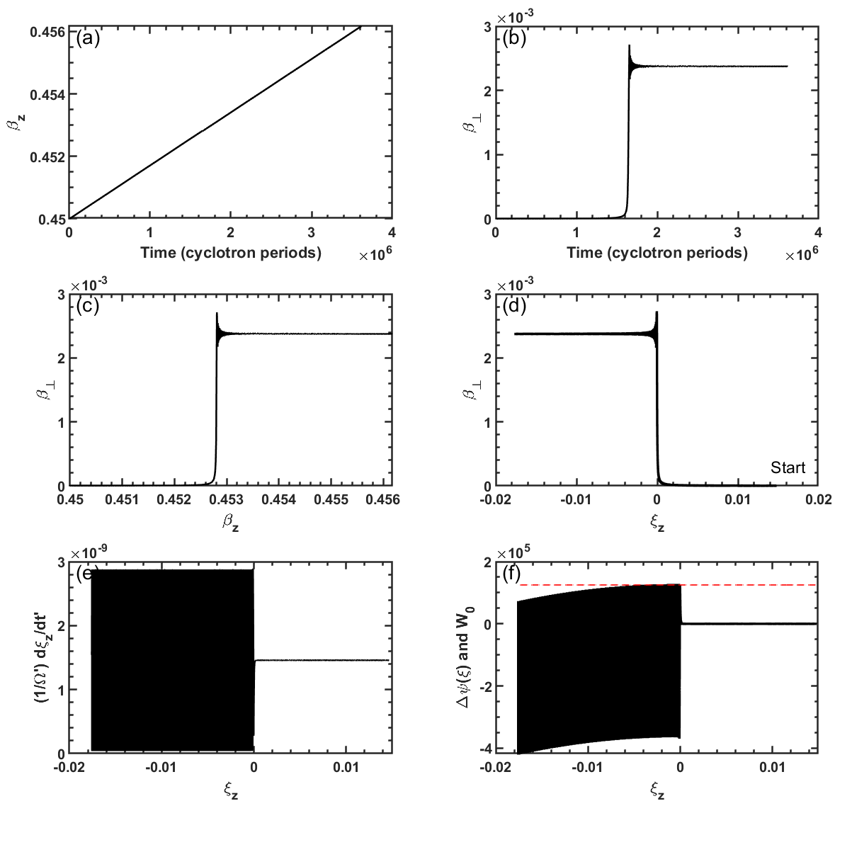
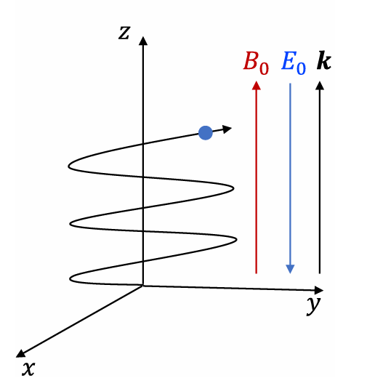
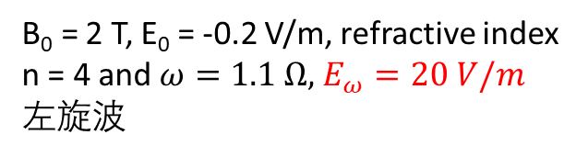

Trapping in anomalous doppler resonance (g = 1)
Unstrapping situation
B₀​ = 2 T, E₀ = -0.2 V/m, refractive index n = 4 and $ω=1.1 Ω,$ $E_{ω}=20 V/m$
左旋波
W₀
$$Δψ(ξ)$$

Slide 5
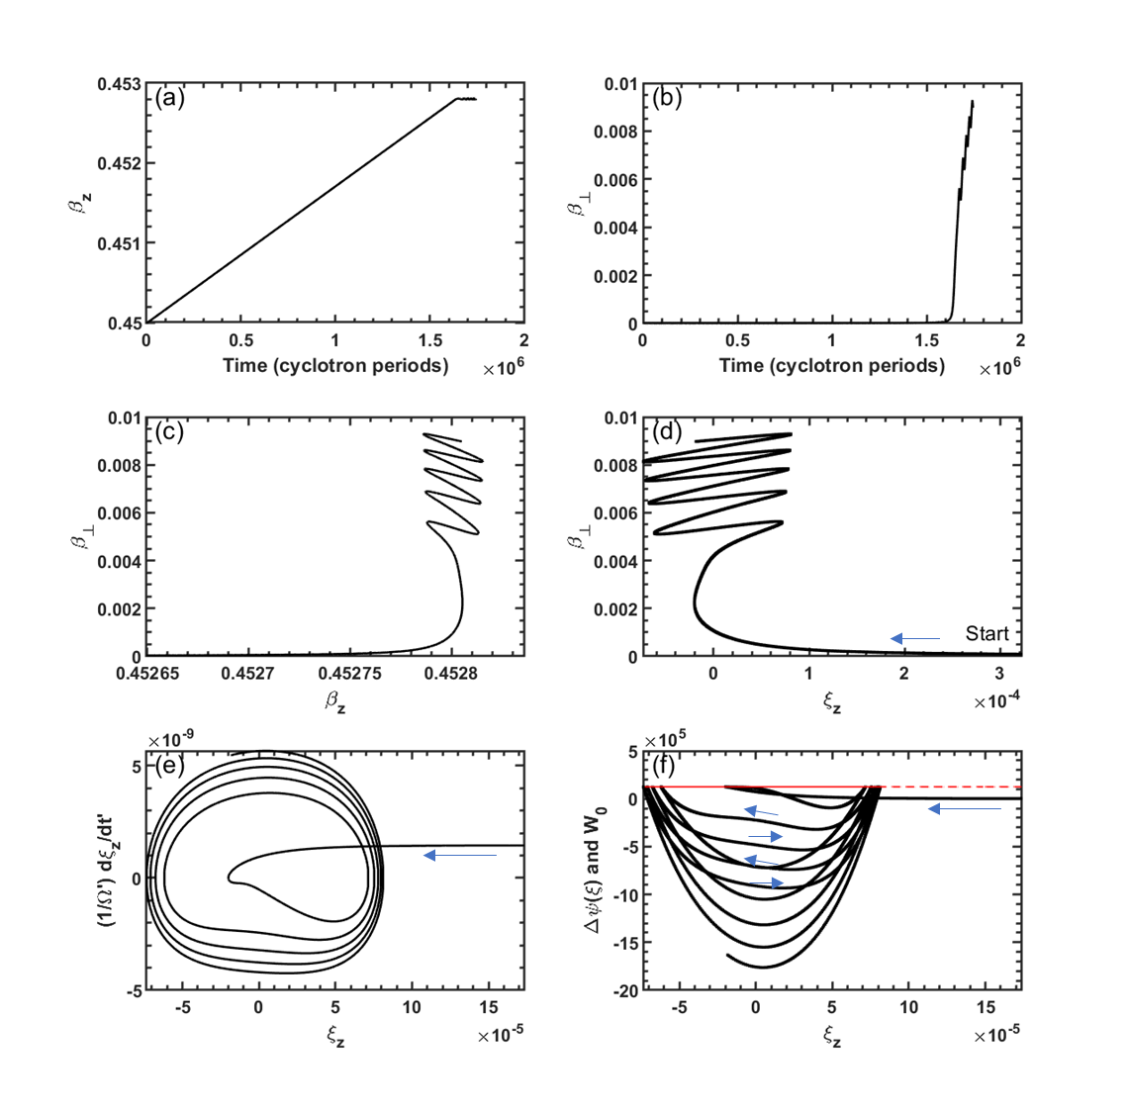

Trapping in anomalous doppler resonance (g = 1)
Trapping situation
Same as Fig. (1) except with $E_{w}$ = 22 V/m.

Slide 6
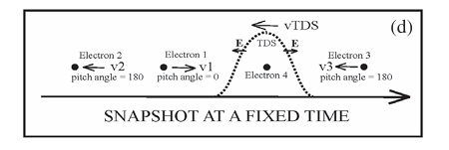




Trapping in normal doppler resonance (g = -1)
Time domain structures (TDS)* in magnetosphere
$$B_{0}$$
$$E_{0}$$
$$k$$
$$k$$
V_{TDS}/c∼ -0.0333
B₀∼64 nT
ω/Ω = −0.845
E₀∼100 mV/m
NDE resonant speed = V_{TDS}
refractive index n = 5.4655
n_{e}∼0.15 cm⁻³
*Direct observation of electron distributions inside millisecond duration electron holes Physical Review Letters 121 135102

Slide 7
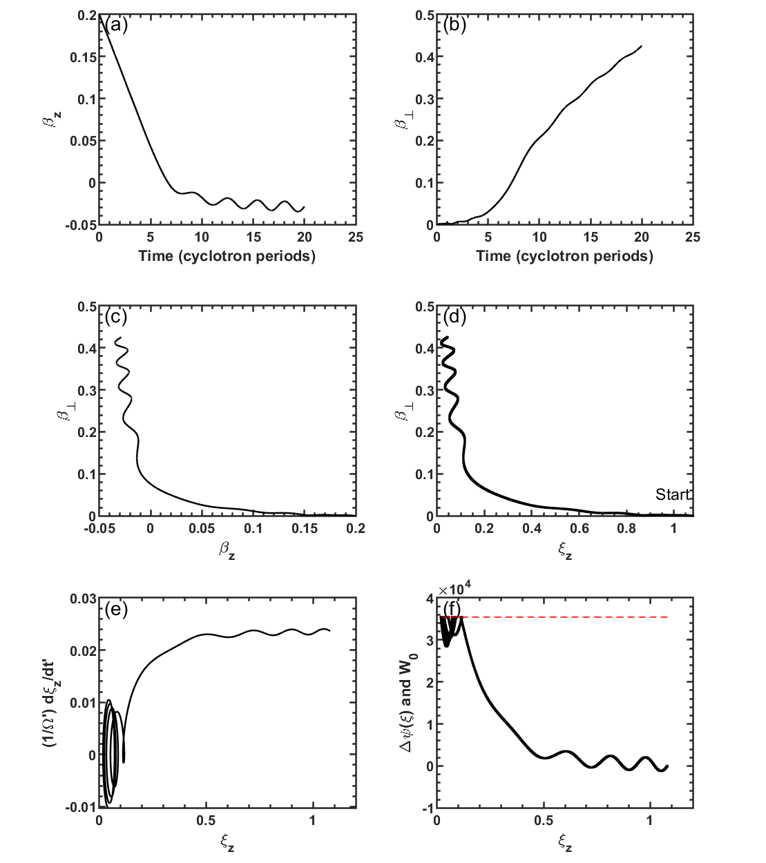

$$k$$
E0 = 100 mV/m,
Ew = 0.3 V/m,
B0 = 64 nT,
ω/Ω = -0.845,
g = -1,
initial β_z= 0.2 and β_⊥=0, ϕ0= 0,
n = 5.4655.

Slide 8
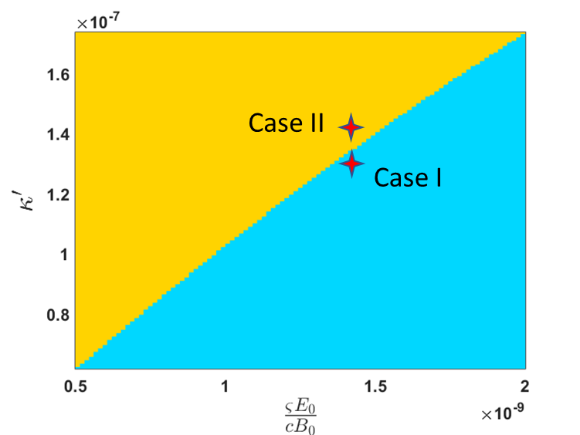
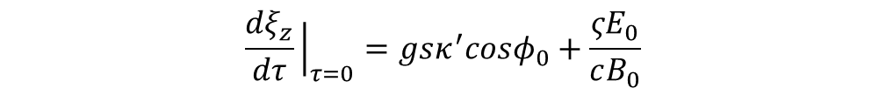
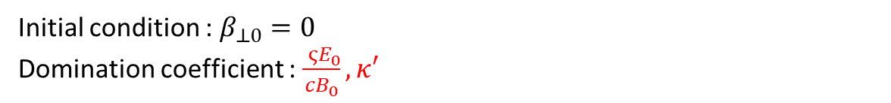
Trapping threshold：Anomalous doppler effect
$$\frac{d^{2}ξ_{z}}{dτ^{2}}=\left(ξ_{z}\left(−\frac{ξ_{z}^{2}−ξ_{z0}^{2}}{2}+\frac{{ ςE}_{0}}{cB_{0}}∫ξ_{z}dτ+αγ_{0}κ^{′}β_{⊥0}\sin{φ_{0}}\right)−\left(ξ_{z}−1\right)κ^{′2}\right)$$
$$\frac{dξ_{z}}{dτ}{\left.​\right|}_{τ=0}=gsκ^{′}cosφ_{0}+\frac{{ςE}_{0}}{cB_{0}}$$
Where $s=\frac{ωnβ_{⊥0}γ_{0}}{Ωγ_{T}}$
Initial condition : $β_{⊥0}=0$
Domination coefficient : $\frac{{ ςE}_{0}}{cB_{0}},κ′$

Slide 9
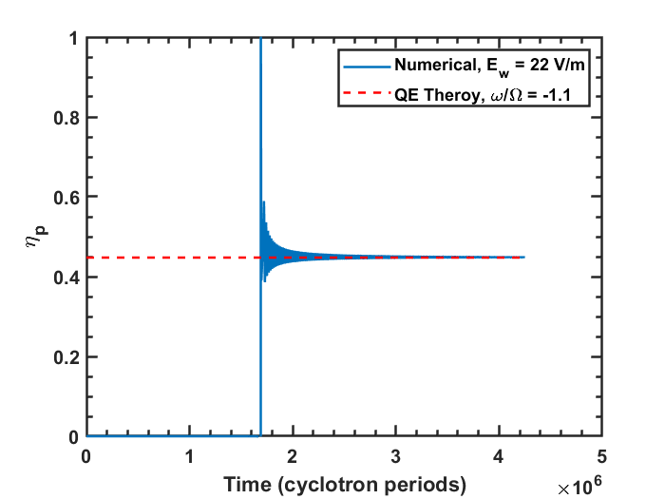

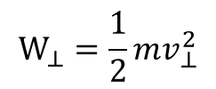
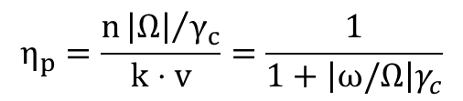
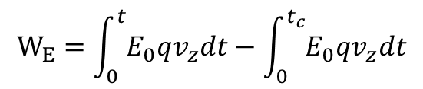
Quantum benchmark： energy transfer ratio
Classical results
$η_{p}=W_{⊥}/W_{E}$
$$W_{E}=\int_{0}^{t}{E_{0}qv_{z}dt}−\int_{0}^{t_{c}}{E_{0}qv_{z}dt}$$
$$W_{⊥}=\frac{1}{2}mv_{⊥}^{2}$$
Quantum results
$$η_{p}=\frac{n{\left|Ω\right|}/{γ_{c}}}{k⋅v}=\frac{1}{1+\left|ω/Ω\right|γ_{c}}$$

Slide 10
Discussion :
Trapping phenomenon explanation from momentum conservation and angular conservation
Potential application in plasma heating and runaway suppression
Space Plasma Dynamics(particle acceleration, precipitation)

Slide 11
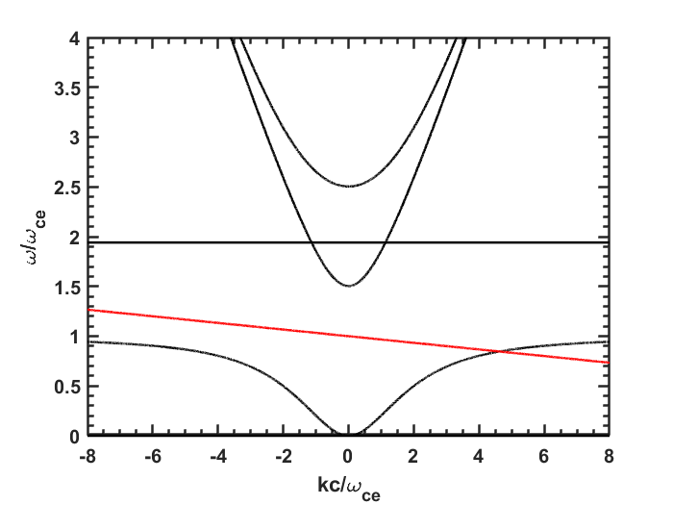
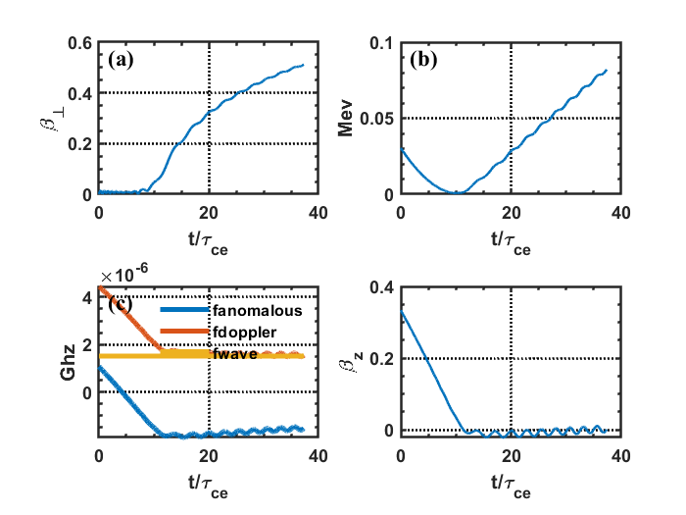

Trapping in normal doppler resonance (g = -1)
Time domain structures (TDS)* in magnetosphere
B₀∼64 nT
$$B_{0}$$
$$E_{0}$$
$$k$$
$$ω=k⋅v_{TDS}+|ω_{ce}|$$
(4.646,0.845)
V_{TDS}/c∼ -0.0333
B₀∼64 nT
ω/Ω = −0.845
NDE resonant speed = V_{TDS}
E₀∼100 mV/m
refractive index n = 5.4655
n_{e}∼0.15 cm⁻³
*Direct observation of electron distributions inside millisecond duration electron holes Physical Review Letters 121 135102

Slide 12



Trapping in normal doppler resonance (g = -1)
Time domain structures (TDS)* in magnetosphere
B₀∼64 nT
$$B_{0}$$
$$E_{0}$$
$$k$$
无交点
(4.646,0.845)
V_{TDS}/c∼ -0.0333
B₀∼64 nT
E₀∼100 mV/m
n_{e}∼0.15 cm⁻³
*Direct observation of electron distributions inside millisecond duration electron holes Physical Review Letters 121 135102

Slide 13
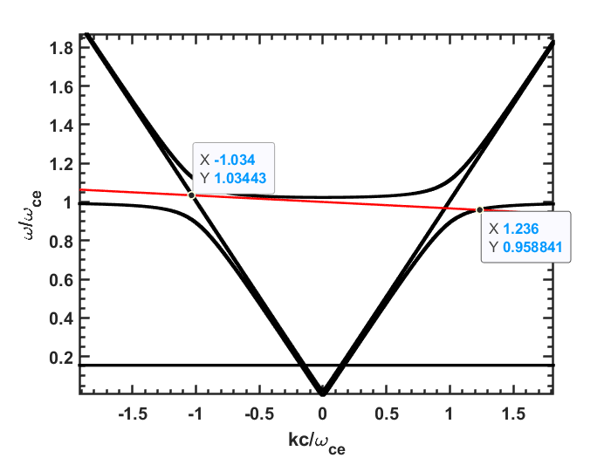
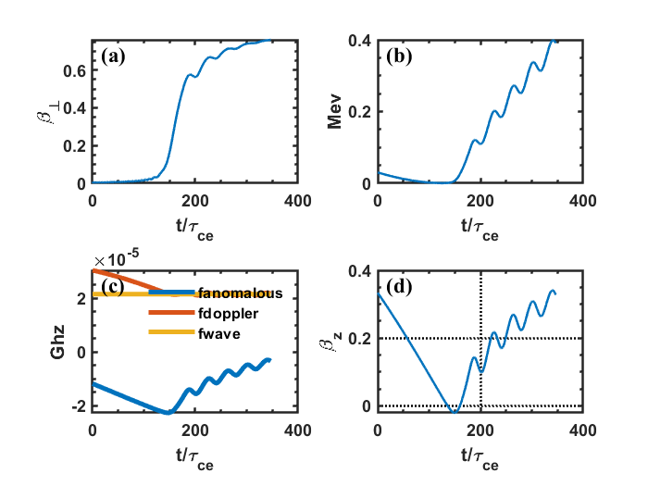
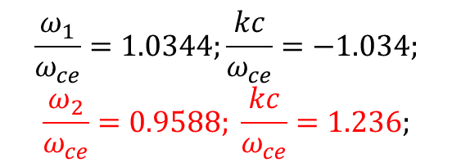

Trapping in normal doppler resonance (g = -1)
B₀∼800 nT
Time domain structures (TDS)* in magnetosphere
$$ω=k⋅v_{c}+|ω_{ce}|$$
$$B_{0}$$
$$E_{0}$$
$$k$$
V_{TDS}/c∼ -0.0333
$$\frac{ω_{1}}{ω_{ce}}=1.0344;\frac{kc}{ω_{ce}}=−1.034;$$
$$\frac{ω_{2}}{ω_{ce}}=0.9588; \frac{kc}{ω_{ce}}=1.236;$$
B₀∼800 nT
E₀∼100 mV/m
n_{e}∼0.15 cm⁻³
*Direct observation of electron distributions inside millisecond duration electron holes Physical Review Letters 121 135102

Slide 14
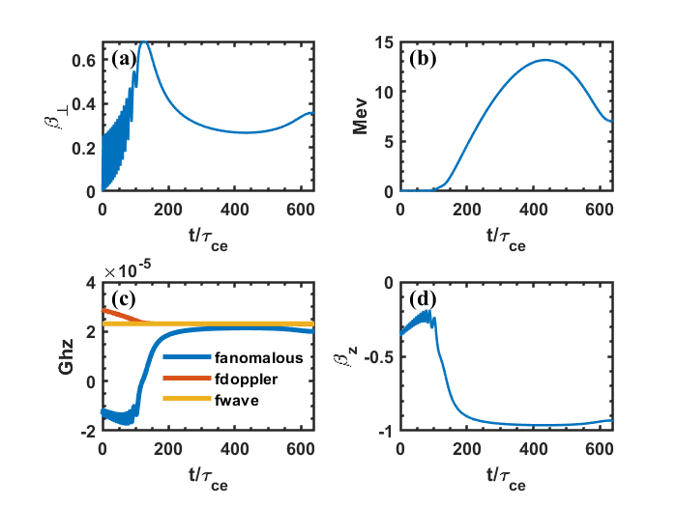
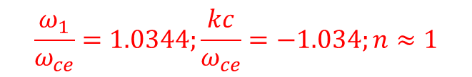



Trapping in normal doppler resonance (g = -1)
B₀∼800 nT
Time domain structures (TDS)* in magnetosphere
$$ω=k⋅v_{TDS}+|ω_{ce}|$$
$$B_{0}$$
$$E_{0}$$
$$k$$
V_{TDS}/c∼ -0.0333
B₀∼800 nT
$$\frac{ω_{1}}{ω_{ce}}=1.0344;\frac{kc}{ω_{ce}}=−1.034;n≈1$$
E₀∼100 mV/m
$$ω=k⋅v_{c}+|ω_{ce}|$$
$$1=n⋅β_{zc}+|ω_{ce}|/ω$$
n_{e}∼0.15 cm⁻³
Ap=12.75 V/m
*Direct observation of electron distributions inside millisecond duration electron holes Physical Review Letters 121 135102
Notes:
洛伦兹因子增加，电子回旋频率减小，平行速度增加以保持共振频率匹配，同时质量增大导致垂直方向速度下降。 但是为什么相对论能量在400tau_ce 后下降?波在吸收和释放中震荡。
?

Slide 15
Some important theory about auto resonance
Nonlinear Resonances, pendulum system , Page 294
J. Fajans, L. Friedland, Am. J. Phys. 69, 1096 (2001)

Slide 16
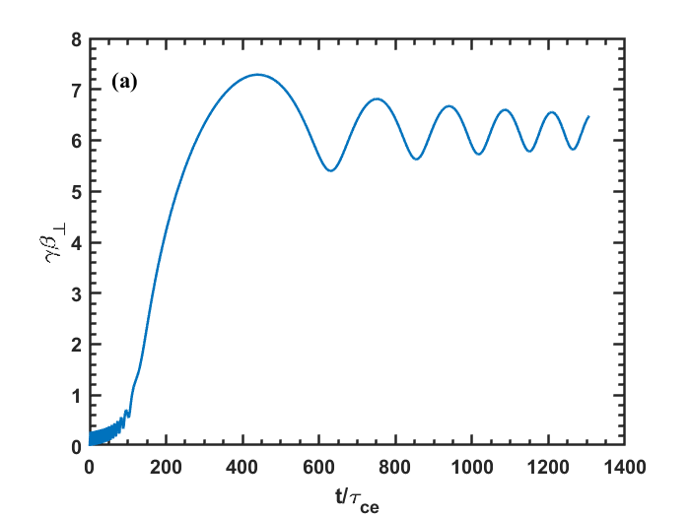

Slide 17
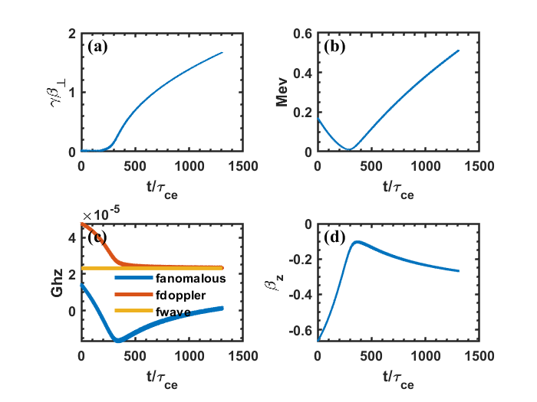
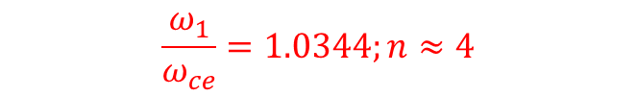
$$\frac{ω_{1}}{ω_{ce}}=1.0344;n≈4$$
$$B_{0}$$
$$E_{0}$$
$$k$$

Slide 18
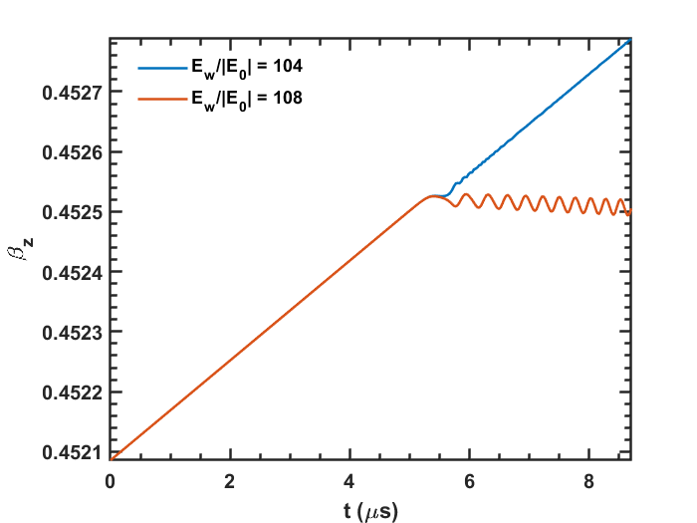
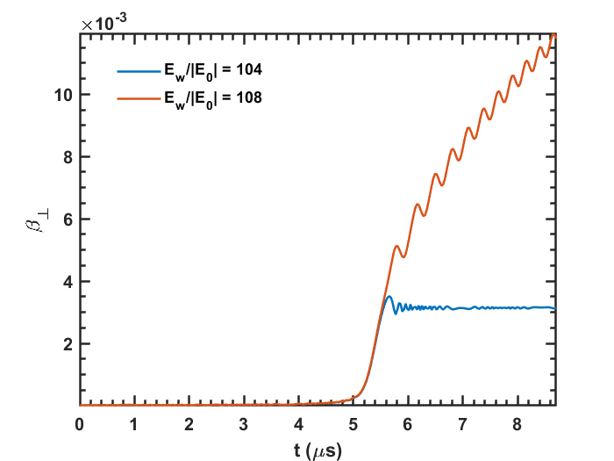
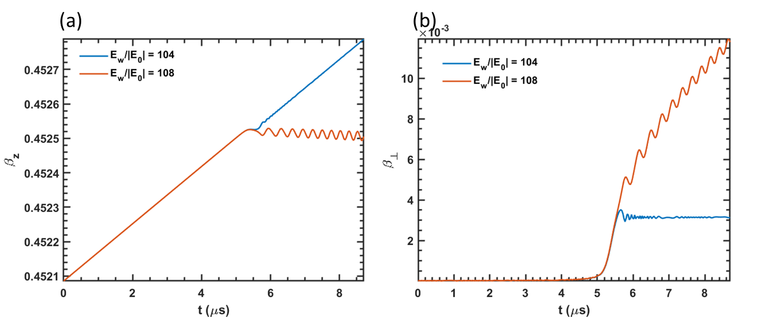
(a)
(b)

